Slide 1
Introduction TO HTML & CSS

Slide 2
CSS

Slide 3
- What is CSS :
- The main format for CSS :
Selector {
Property : Value ;
}

Slide 4
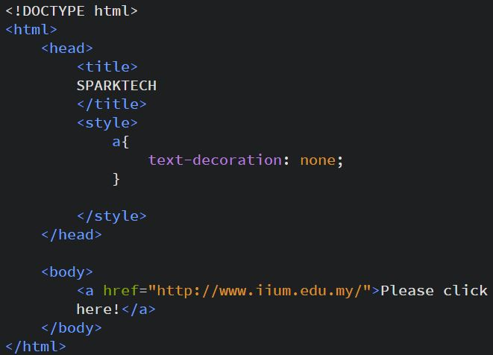
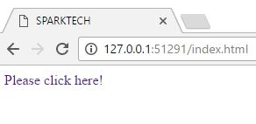
- To make the link without decoration :

Slide 5
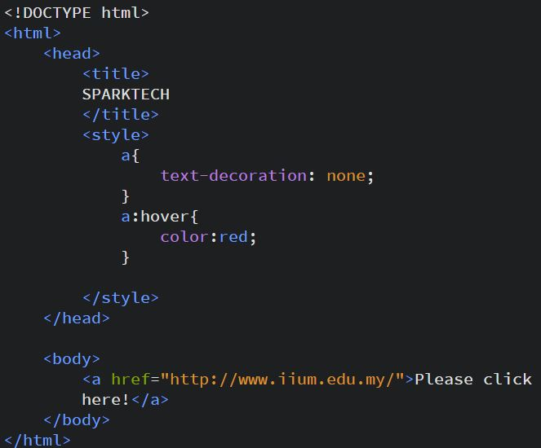
- To change the color of any text including links when hover action fired :

Slide 6
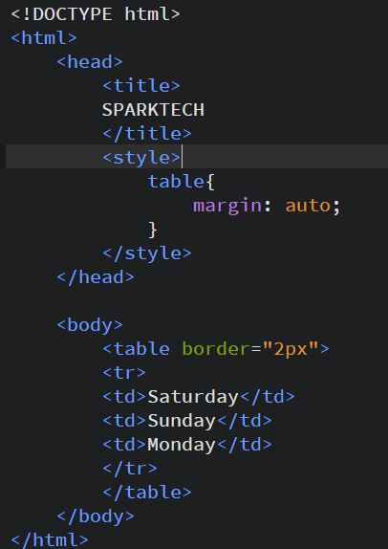
How to make the table
and the button in
the center :

Slide 7
- First child & nth-child( ) :
1) Selector: First child{
Property : Value ;
}
2) Selector: nth-child( ){
Property : Value ;
}

Slide 8
- Change whole page characteristics:
*{
Property : Value ;
}

Slide 9
- Project (4) :
30 minutes
By using CSS :
1) Create a link that has :
- No under line and let the color changes when the mouse hovers it.
- change the font size, color and type of the font.
2) Write 4 paragraphs :
- Change the characteristics of the first paragraph and the third one
3) Create a box that has :
- 200 * 200 px
- background color is gray.
- write your name inside it and make it in the center of the box.
- make the box in the center of the page.

Slide 10
- Class :
When you have a bunch of elements that should all receive the same styling.
- Id :
When you have exactly one element that should receive a certain kind of styling.

Slide 11
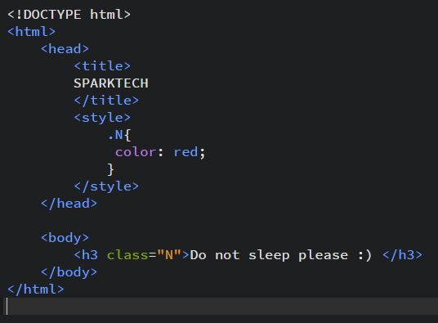
- Class & ID Selector:
- Class in HTML :
<….. Class=“Name”>……..</…>
- Class in CSS :
.Name{
Property : Value ;
}

Slide 12

- Class & ID Selector:
- Id in HTML :
<….. id=“Name”>……..</…>
- Id in CSS :
#Name{
Property : Value ;
}

Slide 13
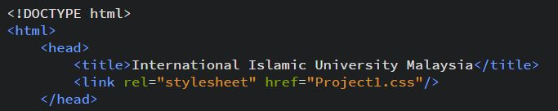
-Link tag to connect the HTML & CSS files :

Slide 14
congratulations
You finished the first part of this course

